Slide 1
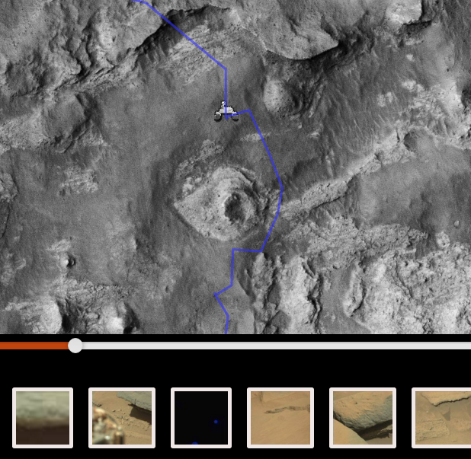
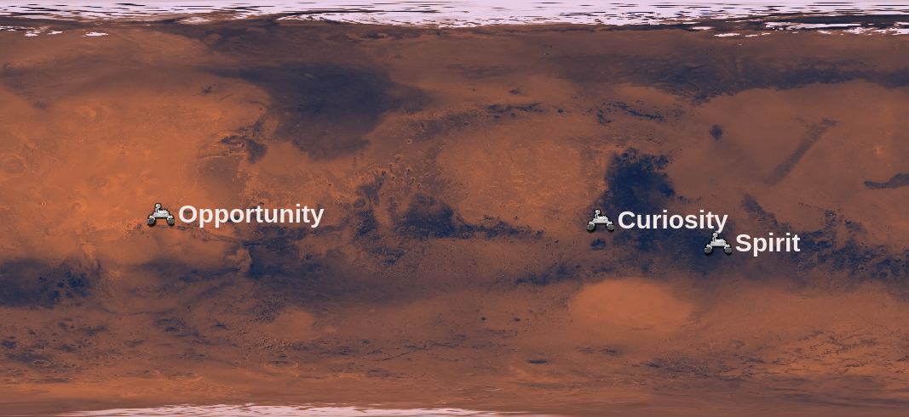
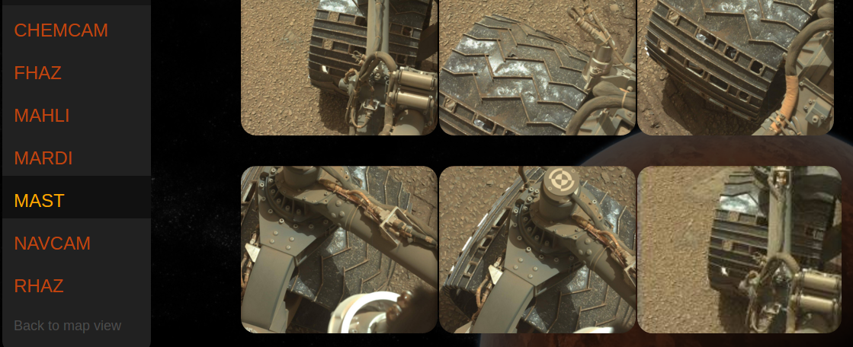
Welcome to Mars!
See the rovers’ locations
Follow the rovers’ paths
View the rovers’ pictures
“Welcome to Mars” allows you to select a rover and trace its path across the martian landscape, before selecting a day (or sol) to examine. Once that is done, you can select which camera to look at.
Go backend caches thumbnails for each sol and adds location data.
Interactive map lets you explore the rover’s route.
Quickly generate collages using Masonry
Stephen Atwood, John Harrison, Will O’Rourke, Mitch Price

